Slide 1
Bikeshare Analysis
Google Data Analysis Certificate Capstone Project
Kristian Murimi

Slide 2
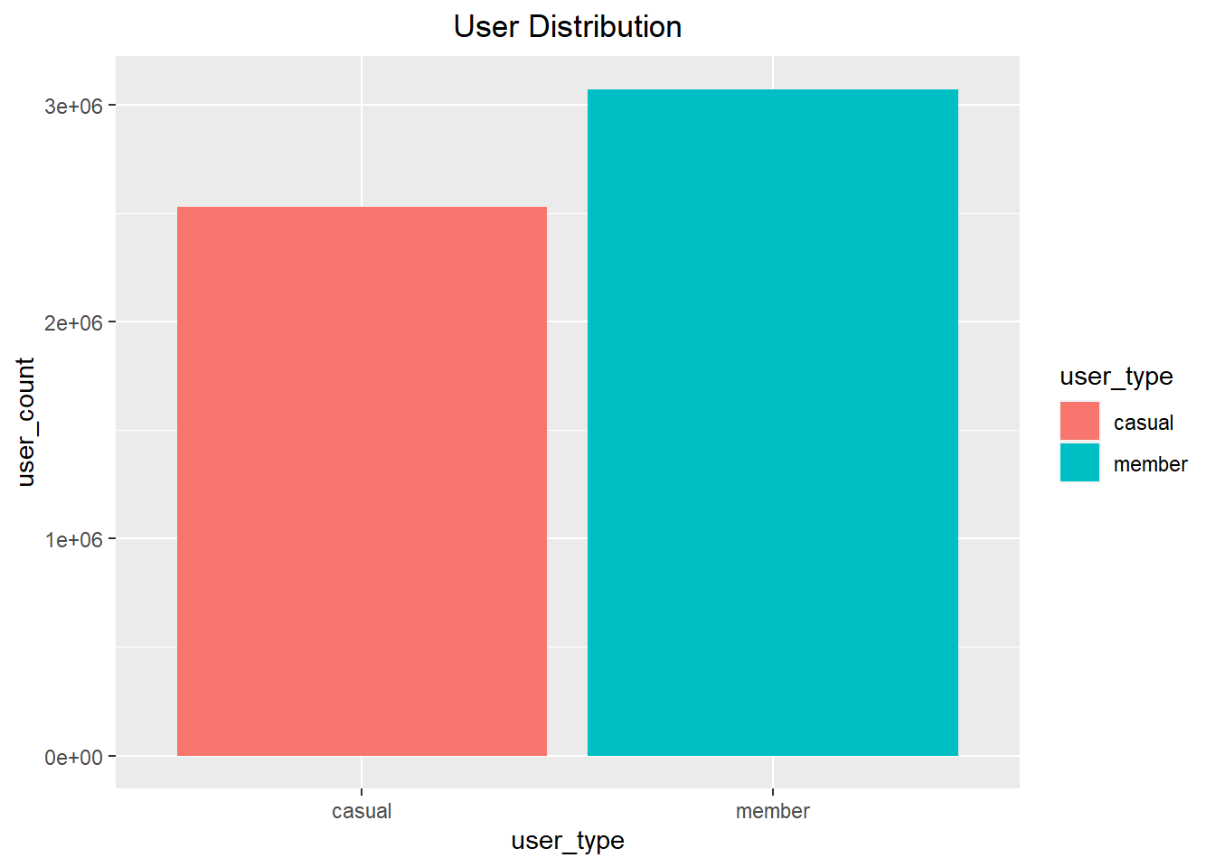
There are more members than casual riders.

Slide 3
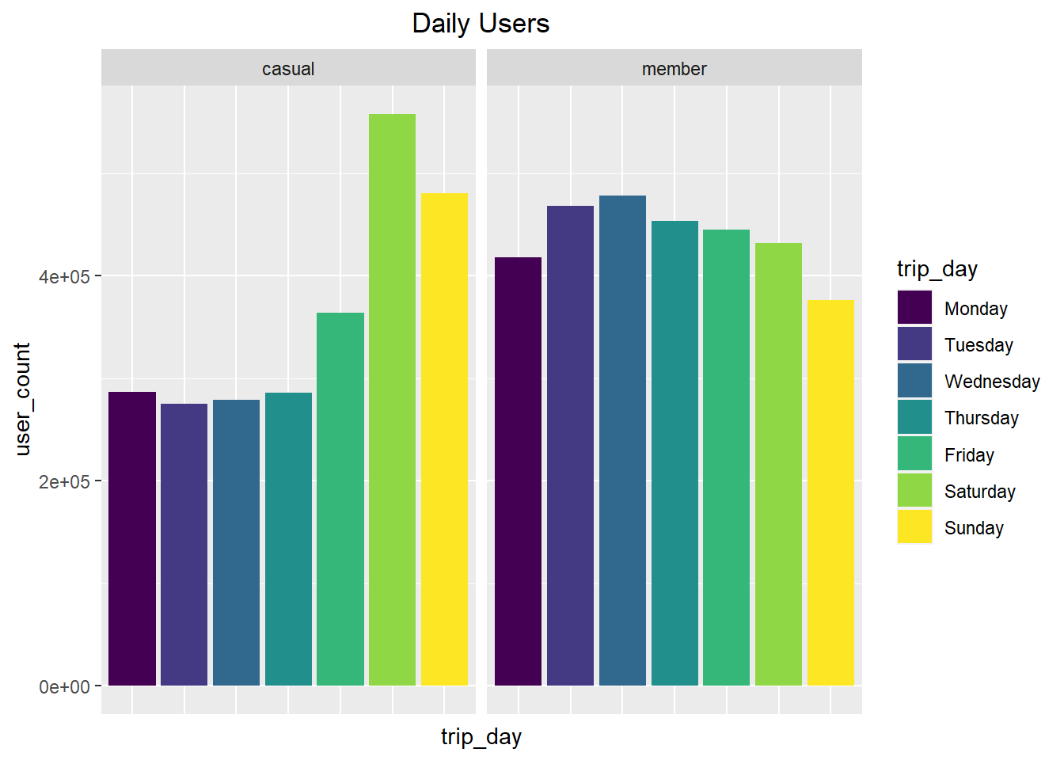
Most of the casual riders take trips on the weekend. This suggests that most casual riders use the bike service for leisure. Members of the ride share service, however, take more trips over the week days. This suggests that most of the members use the service for transport.

Slide 4
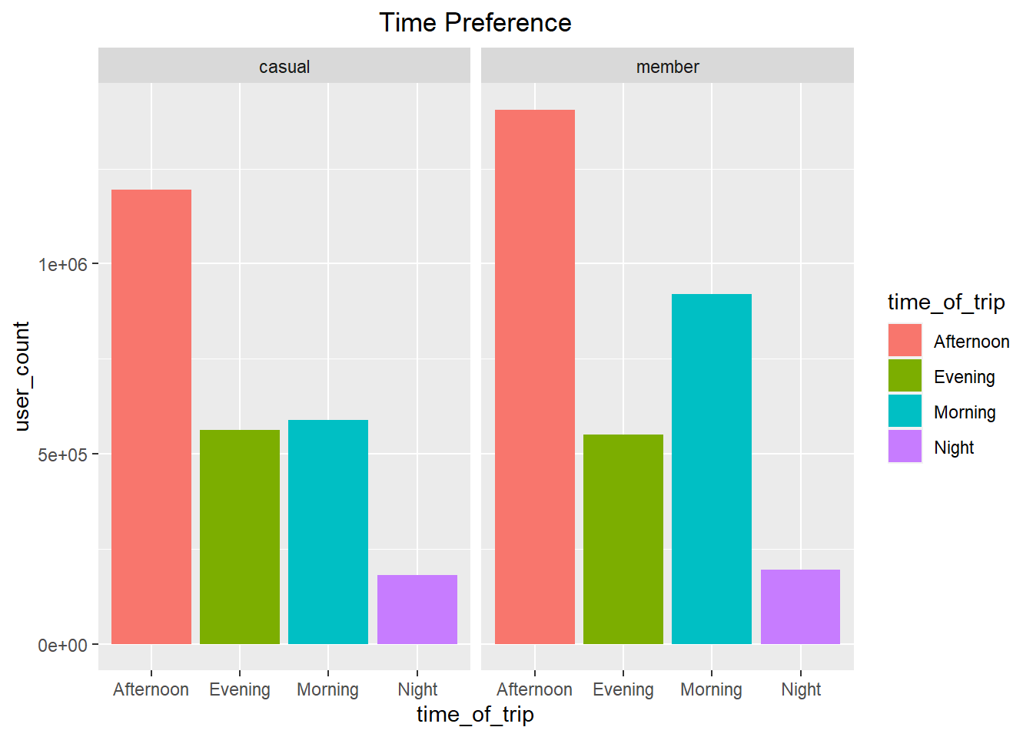
Most of the casual riders use the service in the afternoon suggesting that they use the service mostly for leisure.
The member riders mostly ride in the afternoons and morning which may indicate they are using the service to get to and from work.

Slide 5
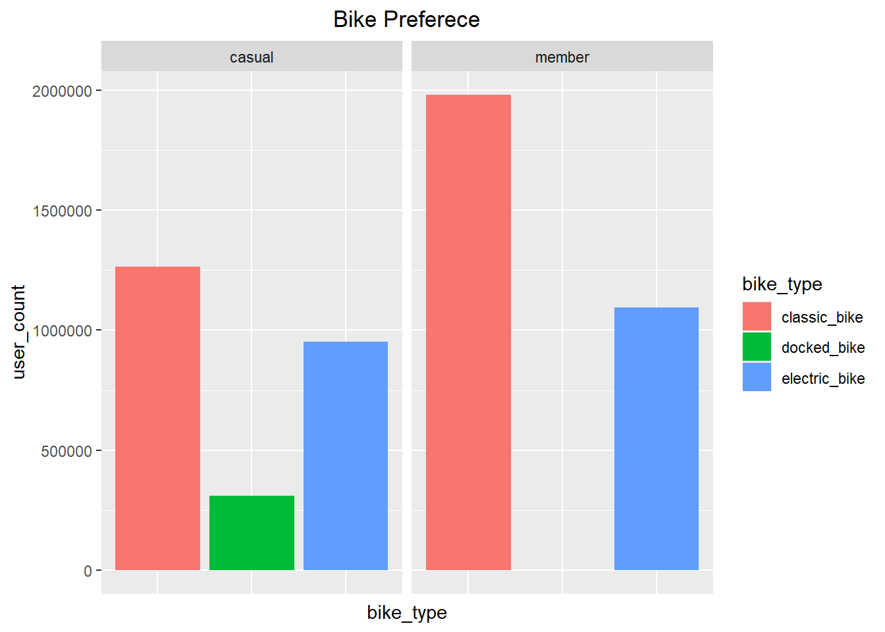
The most used bike type is the classic bike, which is the preferred type by both members and casual riders. The least common bike type is the docked bike which is only used by a small number of casual riders and not at all by members.

